Slide 1
Predicting Skincare Product Price
Predicting pricing and popularity of skin care products via regression models
Crystal Han

Slide 2
Introduction
How will skincare products rise based on several features?
How will do skincare products fare in the current market and future market?
Makeup is included within skincare products

Slide 3
Methodology
Tools:
Python, Pandas, Numpy: Data Cleaning
Matplotlib, seaborn, BeautifulSoup
Selenium: Scrape sephora website
Statsmodels, scikit-learn: Create regression models

Slide 4
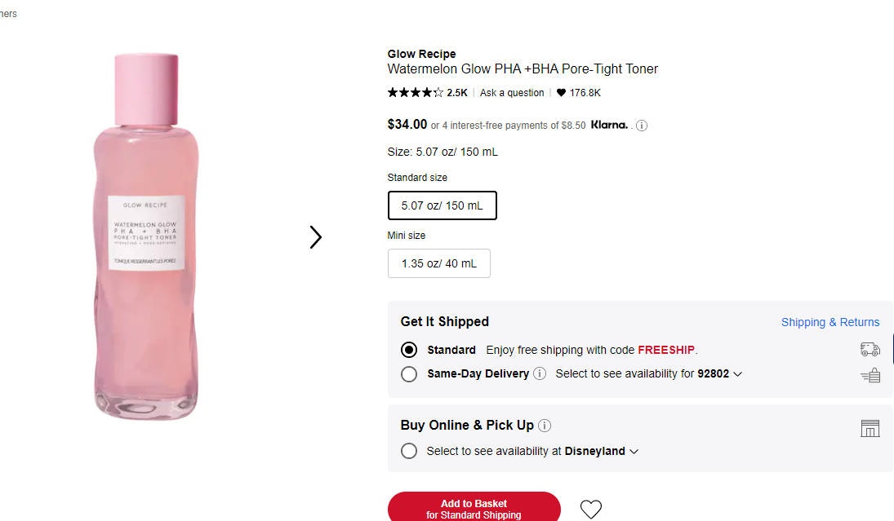
Data
Data
Sephora skin care products data via web scraping with Selenium
1000+ data points collected

Slide 5
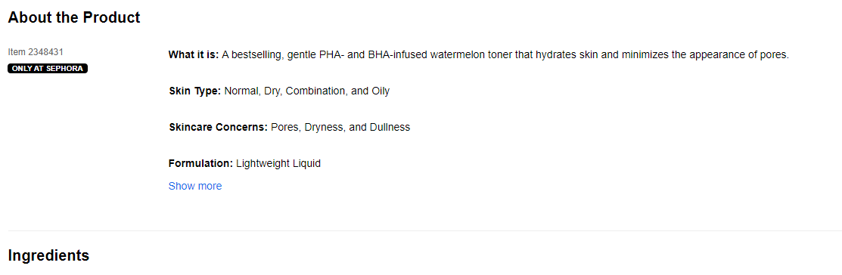
Features
Continuous: Reviews, Number of Reviews, Number of Likes
Categorical: Skin type, ingredients, brand,

Slide 6
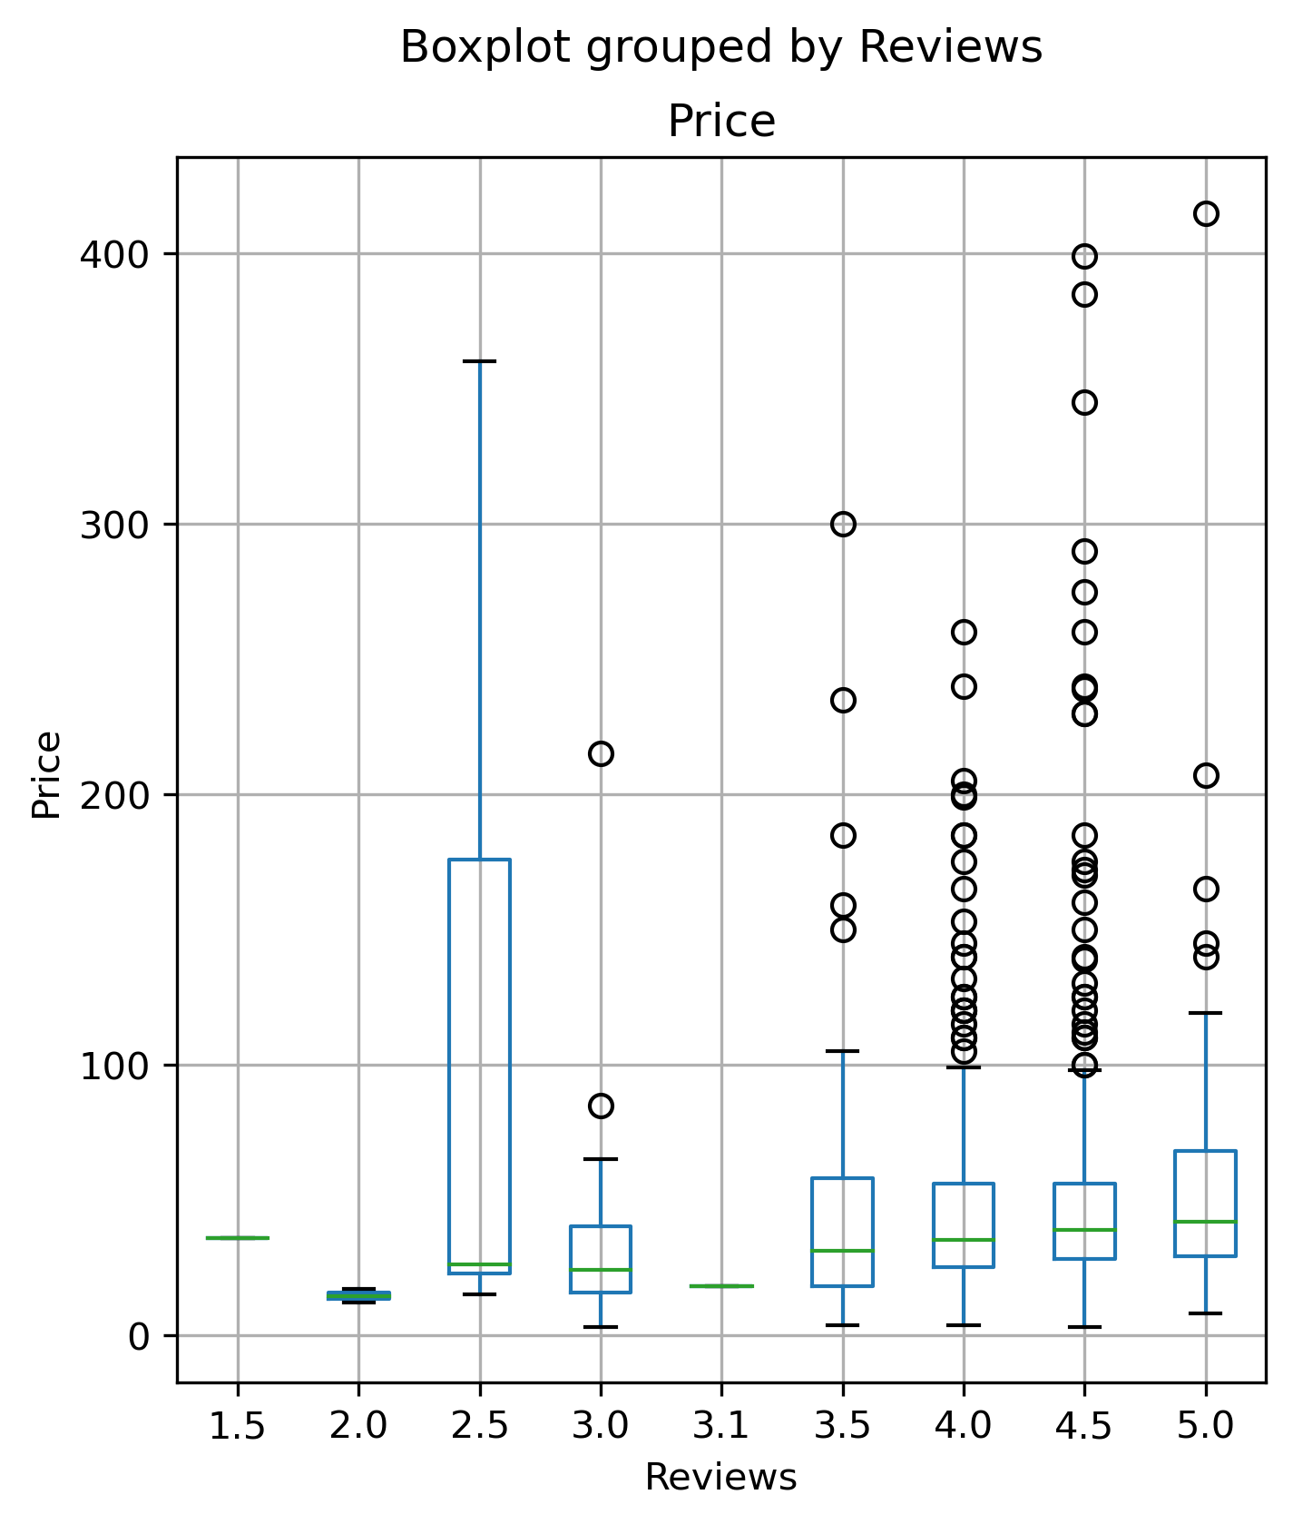
Reviews vs Price
Relationship between Price and Reviews
Higher price not necessarily good review

Slide 7
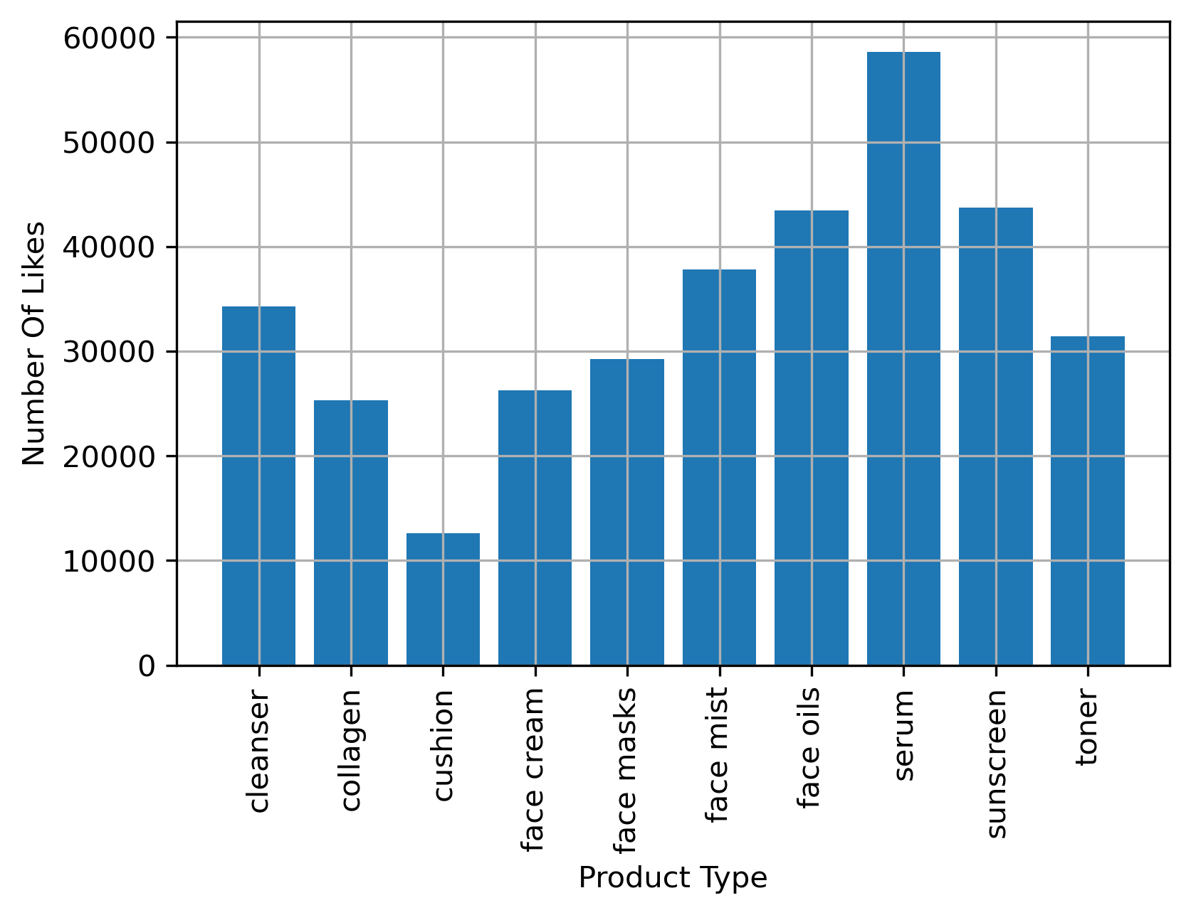
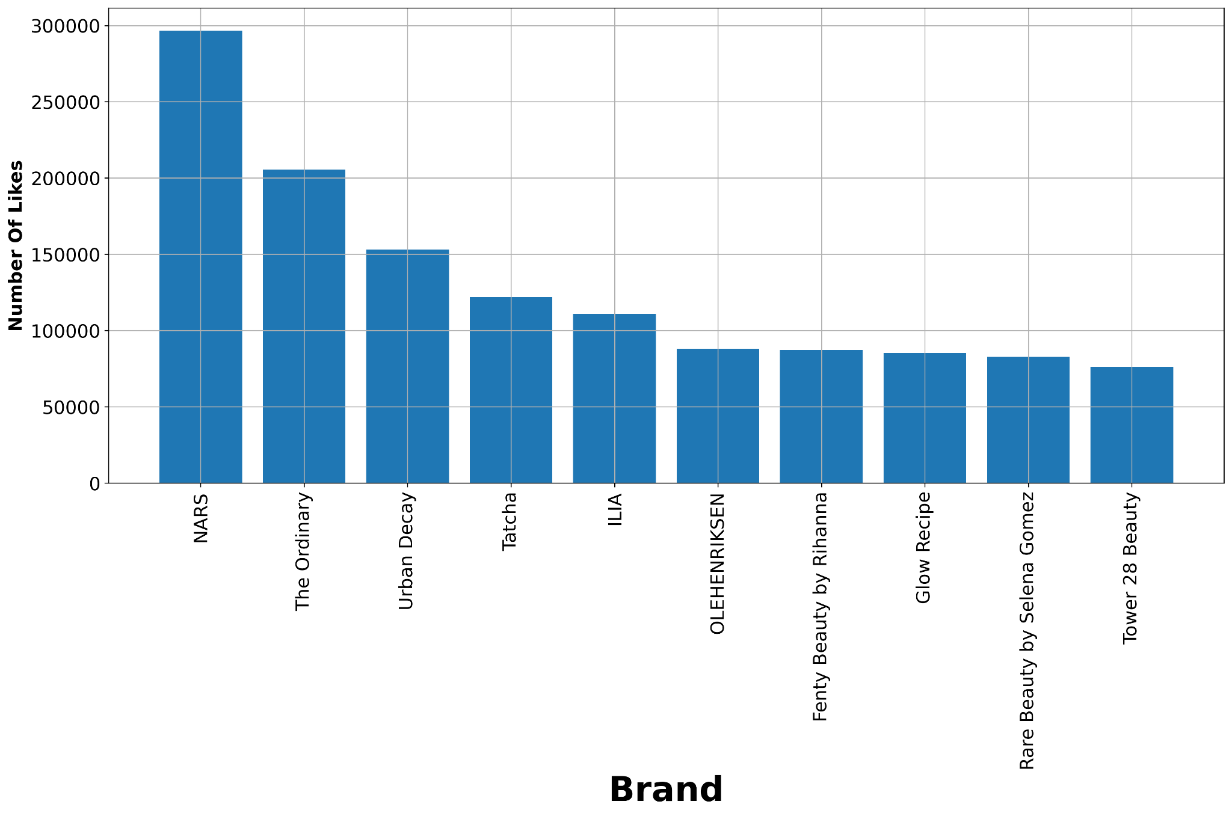
Number of Like vs Product Type and Brand

Slide 8
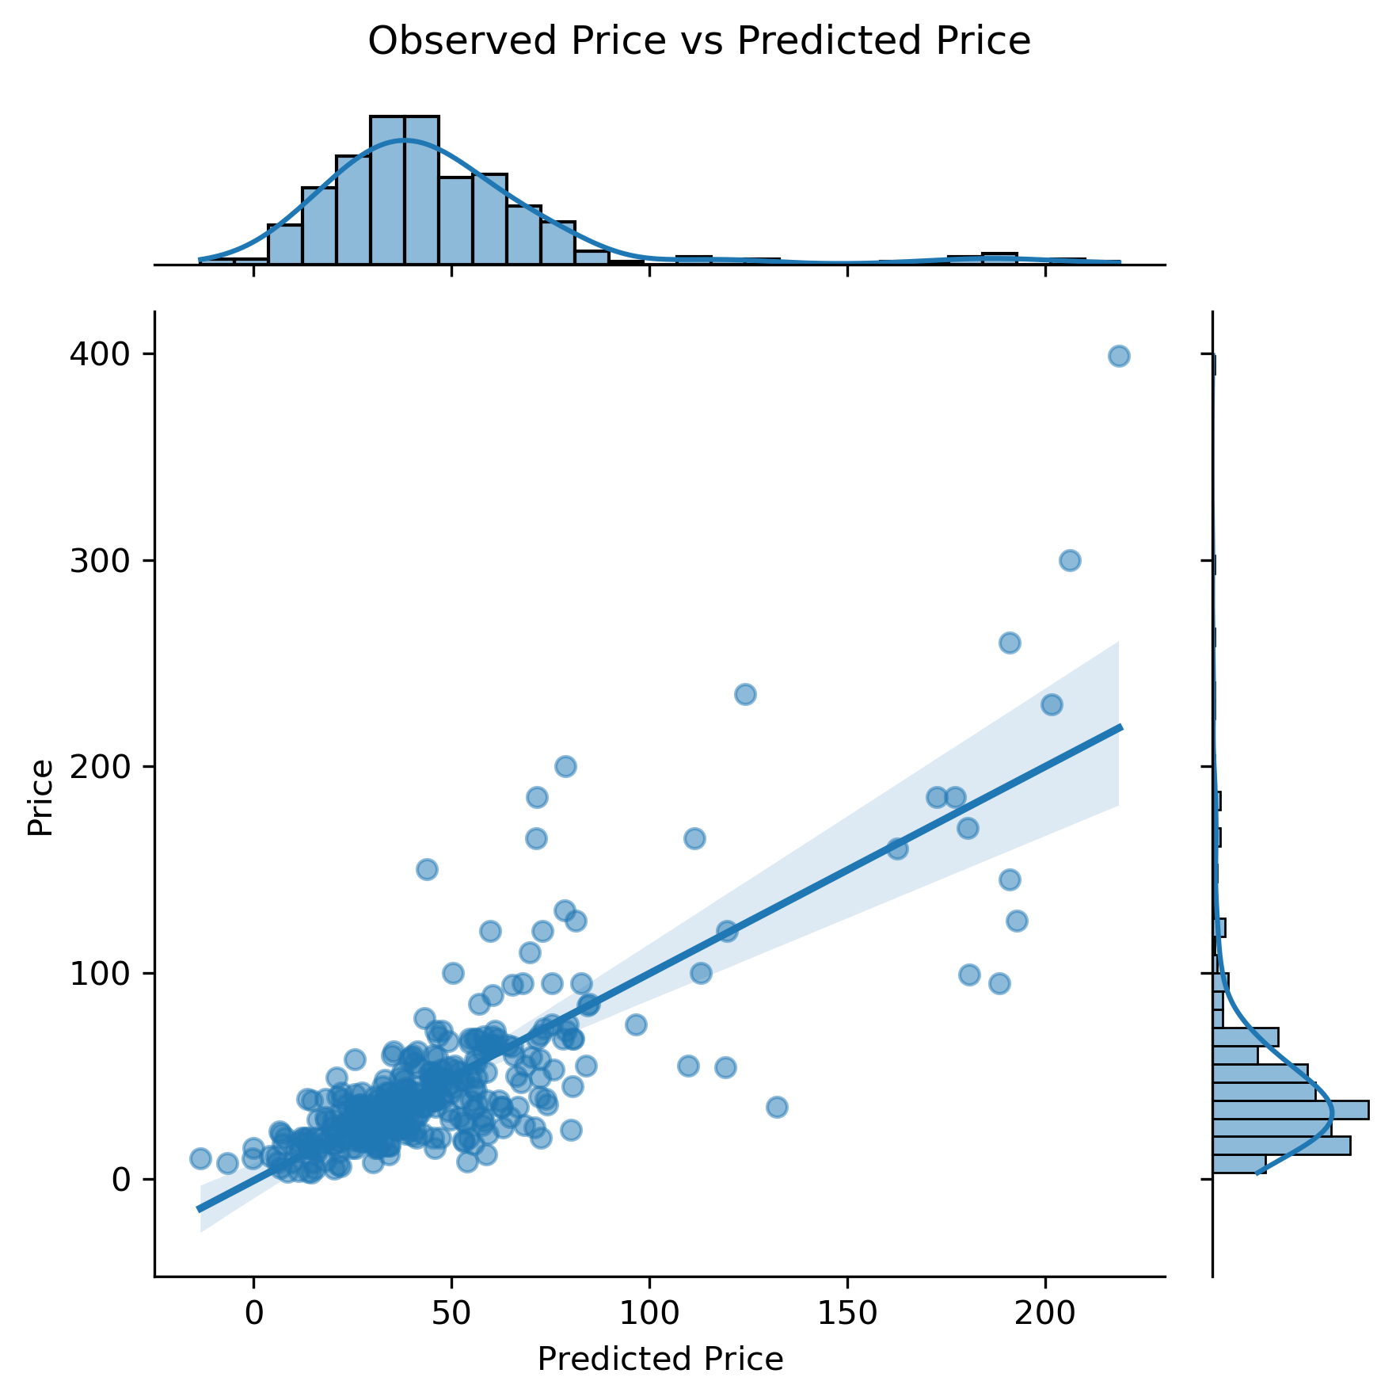
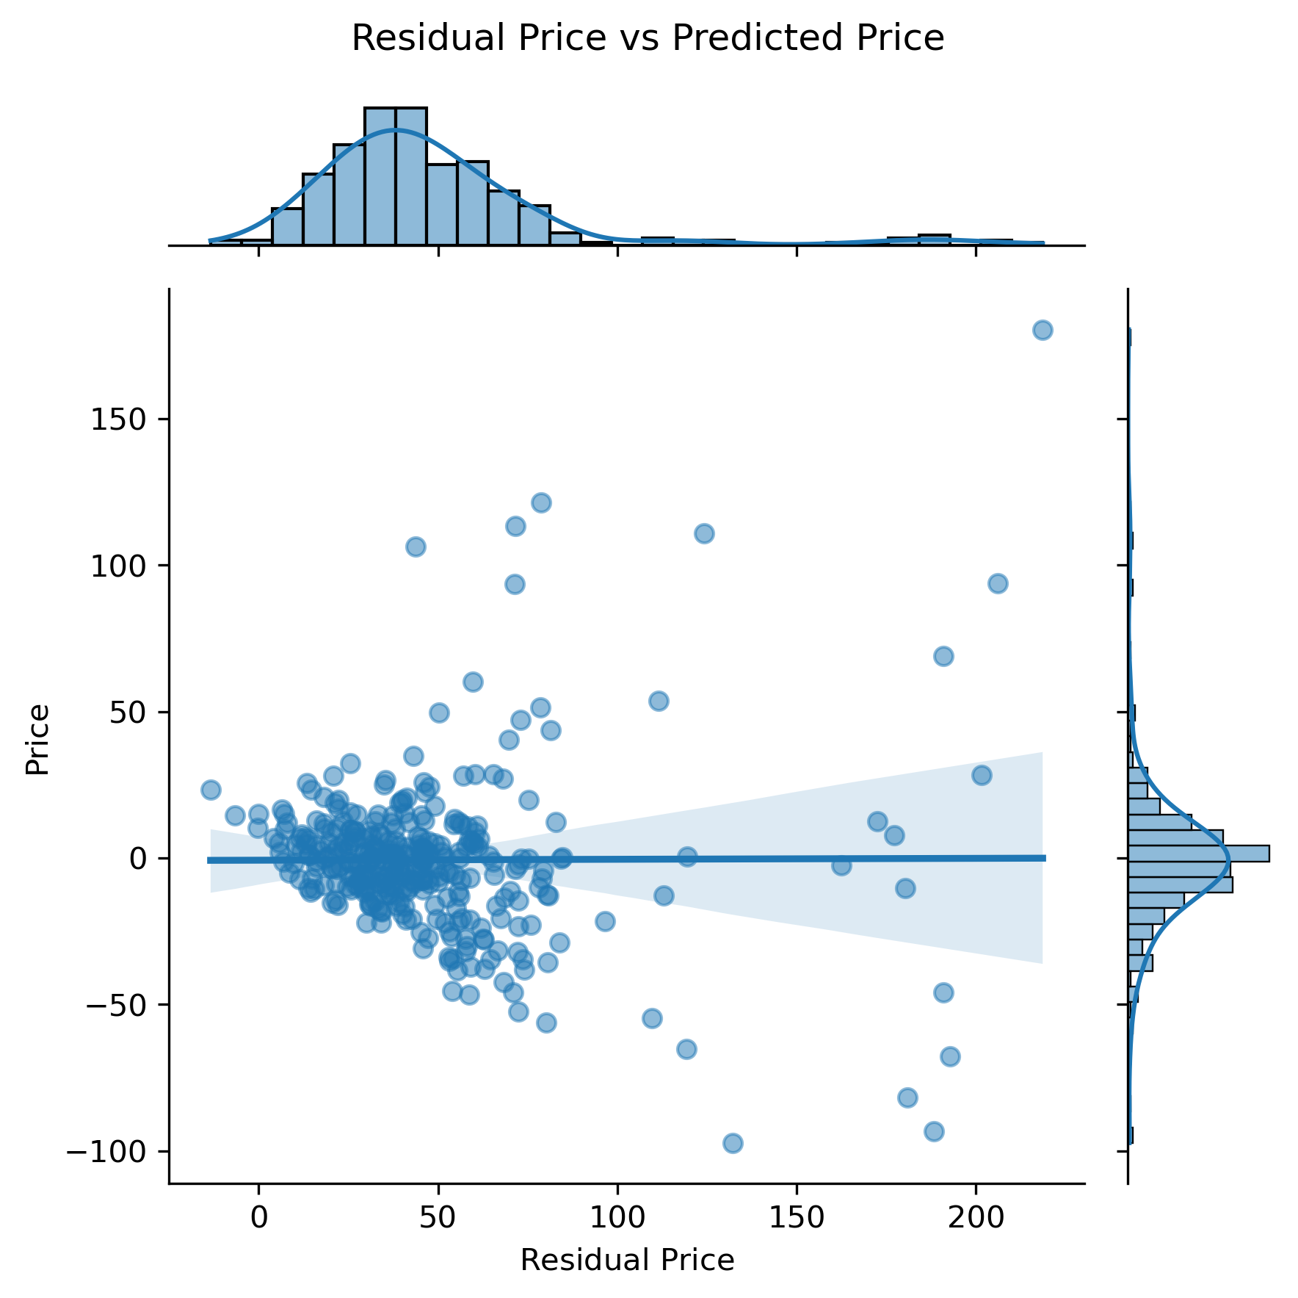
Lasso Regression

Slide 9
R^2 Values of Regression Models
Train/Validation/Test | R² | Cross Validation/Test | R² | Mean Absolute Error
Linear Regression | 0.6362 | Linear Regression | 0.6024 | 16.3508
Ridge Regression | 0.6362 | Ridge Regression | 0.6030 | 16.3413
Lasso Regularization | 0.6363 | Lasso Regularization | 0.6024 | 16.3398
Polynomial Regression | 0.6362 | Polynomial Regression | 0.6020 | 16.2660

Slide 10
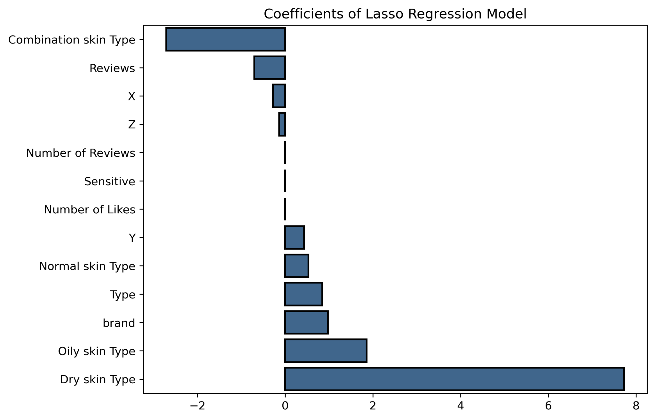
Features Affecting Price
Notes:
Variables x y and z use Tsne (t-distributed stochastic neighborhood embedding: Converts similarities between data points to joint probabilities and tries to minimize the divergence between joint probabilities
Attempt to visualize several features into 2-3 dimensions
Better to use TCA for dimensionality reduction for ingredients

Slide 11
Future Work
Gathering skin care product information from other websites such as Ulta, OliveYoung, YesStyle, etc.
Getting more numerical features and clinical data
Comparison between top products, skincare vs makeup products
Rank ingredients using ordinal encoding

Slide 12
Conclusion
Used Lasso Regression because of Mean Absolute Error
Price range of most skincare products: ~$15.00 to ~$100.00

Slide 13
Appendix
1000+ data points on skincare products:
Toner
Cleansers
Facial Cream
Facial Sheet masks
Sunscreen
Cushions
Data cleaning: Products with no reviews will be considered as 5 stars so as not to assume they are bad products
Reasons for selecting products:
Used in skincare steps
Skin suitability based on types:Normal, Oily, Combination, Sensitive
Makeup as a daily skincare product as well
Ingredients:
Retinol, Ascorbic Acid, Niacinamide, Ceramide, Squalane, Hyaluronic Acid, Vitamin E, Titanium Dioxide, Glycolic Acid, Sodium Acetate, Sodium Benzoate, Sodium Hyaluronate, Panthenol

Slide 14
Thank you

